Slide 1
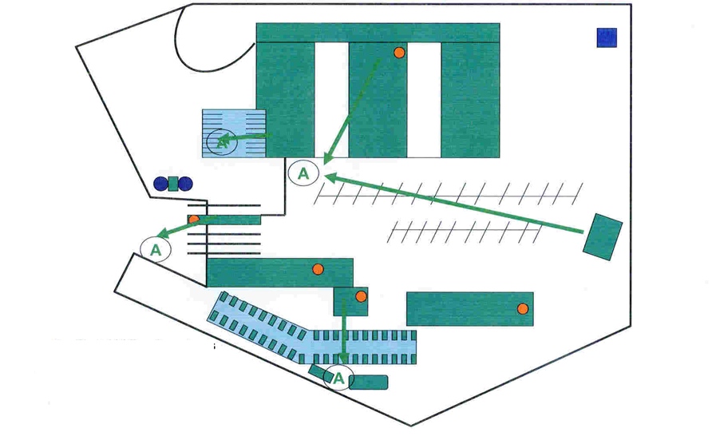
SAB Baragwanath
1
2
3
4
9
5
8
7
6
18
10
19
20
16
15
14
11
17
12
13

